Slide 1
Structured Data Types
Abhijit A M
abhijit.comp@coep.ac.in

Slide 2
Structured Data Types
A structured data type (data structure) is an aggregate which has elements which have a different type
  The components may be elementary data objects or other data structures.
  Data structures may be system-defined or programmer defined.

Slide 3
Some common data structures: (most languages provide at least on or two of these)
  Arrays – multiple components of the same type
  Records – multiple components which may be of different types
  Sets
  Lists
  Hash table
Issues for implementing data structures
  Specification
  Storage management

Slide 4
Data Structure Specification
Number of components
  fixed: arrays, records int a[10] → 10 fixed
  variable: stacks, lists, sets, tables, files
Component type(s)
  homogeneous: arrays, sets, files
  heterogeneous: records, lists
Component Selection
  use a subscript or name a[10] or p.y
  can be direct access or sequential access array vs linked list
Limit on maximum number of components?
Component Organization – contiguous in memory?

Slide 5
Data Structure Operations
whole structure operations
  assignment, parameter passing
  f(struct x) { struct a,b; a = b;. }
    main() {
    struct x b;
    f(b);
  }
  relatively limited in most languages
insertion and deletion of components – only makes sense for some data structures
  inserting in a struct ? Inserting in a linked list.
creation/deletion of entire structure

Slide 6
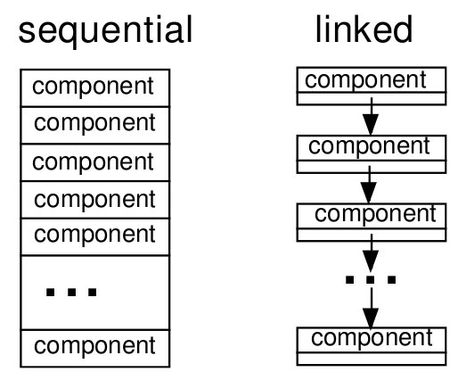
Implementation of Data Structures
Implementing a data structure requires finding a balance between efficient element selection and efficient storage management
  Storage representation
  need component storage and descriptor
  storage may be sequential (contiguous) or linked
  operations need efficient element access
Storage management
  lifetimes of individual components may be different
  aliases to a given object may have different lifetimes than the object itself (garbage and dangling references)

Slide 7
Declarations and Type-checking
data structures have more attributes than scalar types
  type of data structure
  number of components
  component type
type checking more complicated
  static checking not always sufficient
  int a [10], i; ....... a[i] = 10;
  need to know if the element exists
  would like to be sure element has correct type
  a[i] = “pqr”

Slide 8
Arrays
An array is an ordered sequence of identical objects.
Attributes
Number of components, Data type int a[10] → 10 no. of compo, type int
Subscript type and range for element access
  in C, number of components determines the subscript range a[10] → Index 0 to 9
  some languages like Pascal, Ada let you specify a range var a:array[-3..10] of int;
  sometimes (Pascal) enumerated types are allowed as subscripts var a: array[color] of int;

Slide 9
Arrays
Array Operations
  element access – usually a numeric index a[i]= 5;
  creation and destruction of entire array a = new int[10];
  assignment – language dependent: deep vs. shallow copy int a[10],b[10]; a= b;
  arithmetic – APL provides a large set of array operations int a[10]; a+=5;

Slide 10
Arrays, cont.
Implementation
  usually sequential
    homogeniety means components all have the same size
    fixed size of array means component locations don’t change
For some languages, there may also be a run-time descriptor (dope vector)
  upper and lower bounds for bounds checking
  types for dynamic type-checking

Slide 11
Element access for 1-D arrays
A vector is a one-dimensional or linear sequence of elements.
The ordering is determined by a scalar data object (usually integer or enumeration data).
This value is called the subscript or index, and written as A[I] for array A and subscript I.
  Computing the address of I'th element of array
  lvalue(A[I]) = lvalue(A[0]) + I * elementSize

Slide 12
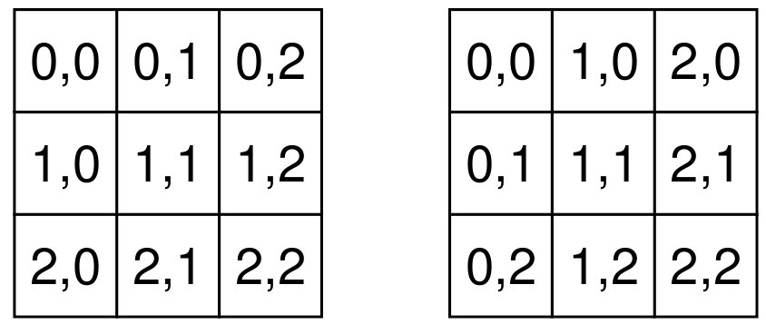
Multi-dimensional Arrays
Multidimensional arrays have more than one subscript.
A 2-dimensional array can be modeled as the boxes on a rectangular grid.
Two-dimensional arrays can be stored in either row-major (most common) or column-major order.
The L-value for array element A[I,J] is given by the accessing formula on the nextslide

Slide 13
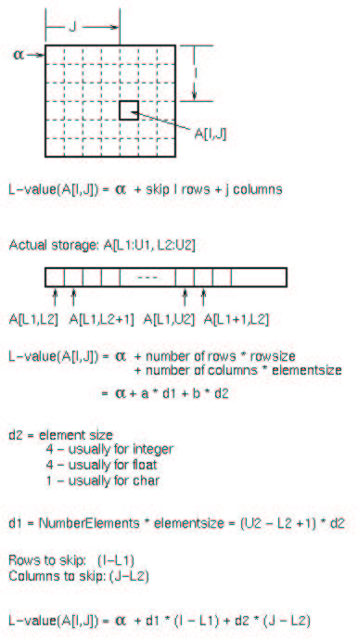
Access
Formula

Slide 14

Dope Vector
A dope vector contains information about the array that is needed at run-time.
  Needed for doing run time checks ( C does not do it !)
  starting address in memory (V0 Virtual Origin)
  total amount of memory allocated (d1)
  element size (d2)

Slide 15
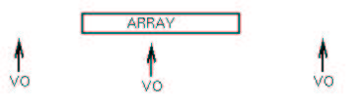
Array Access
1. VO can be a positive or negative value, and can have an address that is before, within, or after the actual storage for the array:
2. In C, VO is the same as the starting address for the element storage since bounds start at 0. Example:
  char A[25]
  L-value(A[I]) = VO + (I-L1) * d1 = + I * 1 = α + I

Slide 16
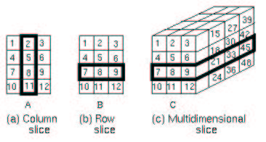
Slices

Slide 17
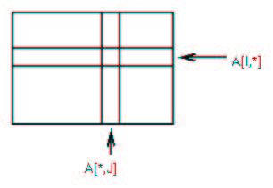
Array slices
Given array : A[L1:U1, L2:U2]:
Give d1, d2, and VO for vector:
Dope vector A[I,*] = B[L2:U2] | Dope vector A[*,J] = B[L1:U1]
VO = L-value(A[I,L2]) - d2*L2 | VO = L-value(A[L1,J]) - d1*L1
M1 = eltsize = d2 | M1 = rowsize = d1
Create new dope vector that accesses original data

Slide 18
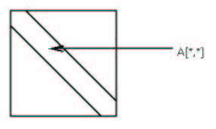
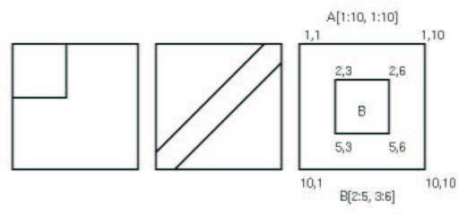
More on slices
Diagonal slices:
  VO = L - value( A[L1, L2])
  - d1 * L1 - d2 * L2
  M1 = d1 + d2
Other possibilities:

Slide 19
Associative arrays
Access information by name without having a predefined ordering or enumeration:
Example: Names and grades for students in a class:
  NAME[I] = name of Ith student
  GRADE[I] = Grade for Ith student
Associative array: Use Name as index:
  CLASS[name] will be grade.

Slide 20
Associative Arrays
Problem: Do not know enumeration before obtaining data so dope vector method of accessing will not work.
Implemented in Perl and in SNOBOL4 (as a table)
A hashtable is a commonly used data structure even when it is not built in to the language. Java has a HashTable class.

Slide 21
Perl example
# % operator makes an associative array
%ClassList = ("Michelle", ’A’, "Doris", ’B’,"Michael", ’D’);
$ClassList{"Michelle"} has the value ’A’
@y = %ClassList # Converts ClassList to an enumeration
# array with index 0..5
$I= 0 $y[$I] = Doris
$I= 1 $y[$I] = B
$I= 2 $y[$I] = Michael
$I= 3 $y[$I] = D
$I= 4 $y[$I] = Michelle
$I= 5 $y[$I] = A

Slide 22
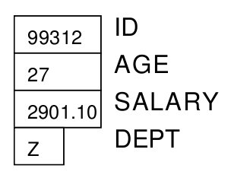
Records
Records are a fixed-length linear data structure like arrays except
  The components may have different types.
  Symbolic names are used for element access.
typedef struct EmployeeType {
int ID;
int AGE;
double SALARY;
char DEPT;
}

Slide 23
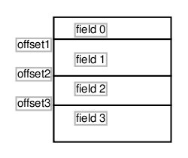
Records
Specification – need name and type of each component
• Implementation
  use single sequential block of memory
  components are stored in order
  position of component relative to start of memory block can be computed at translation time
  L − value(R.I) = α + ∑ {j = 1 .. I − 1 }(sizeof R.j)
descriptors not usually needed

Slide 24
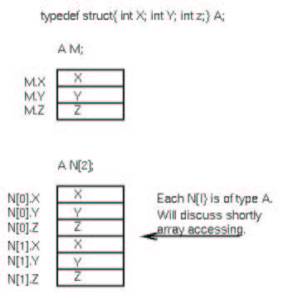
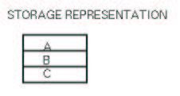
Structs in C
Representation: a sequence of objects
record { A: object;
B: object;
C: object }

Slide 25
Unions and Variant records
Situations often occur when you need one type that has can have different sets of data for different data objects.
Think about your lexeme type - sometimes it needs no value, sometimes a string value, sometimes a numeric value.
Unions and variant records provide this flexibility.

Slide 26

Union types
Unions are similar to records, except all components share the same memory – only one can be used at a time.
typedef union {
int X;
float Y;
char Z[4];} B;
B P;
Unions can be free (no type-checking) o discriminated.

Slide 27
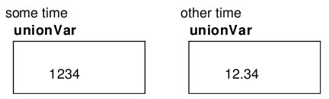
Union types
But problems can occur. What happens below?
  P.X = 1234;
  printf("%O\n", P.Z[3])
All 3 data objects have same L-value and occupy same storage. No enforcement of type checking.
Poor language design

Slide 28
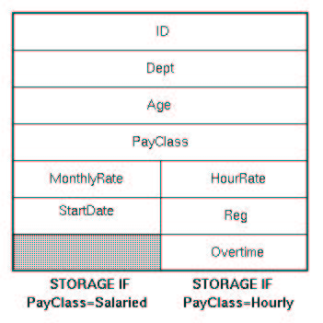
Variant records
type PayType=(Salaried, Hourly);
var Employee:record
ID: integer;
Dept: array[1..3] of char;
Age: integer;
case PayClass: PayType of
Salaried: MonthlyRate:real;
StartDate:integer);
Hourly:(HourRate:real;
Reg:integer;
Overtime:integer)
end

Slide 29

Variant records (continued)
Tagged union type - Pascal variant records
type whichtype = (inttype, realtype, chartype);
type uniontype = record
case V: whichtype of
inttype: (X: integer);
realtype: (Y: real);
chartype: (Z: char4); Assumes string of length 4
end
But can still subvert tagging: What is P.V value now?
var P: uniontype
P.V = inttype;
P.X = 142;
P.V = chartype;

